Slide 1
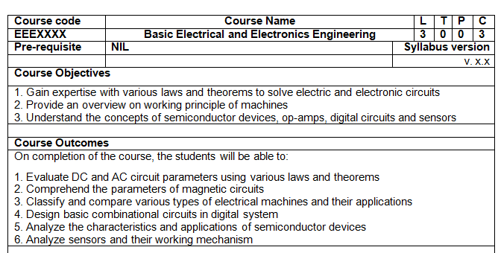
BASIC ELECTRICAL AND ELECTRONICS ENGINEERING (BEEE102L)
COURSE OBJECTIVE AND COURSE OUTCOME

Slide 2
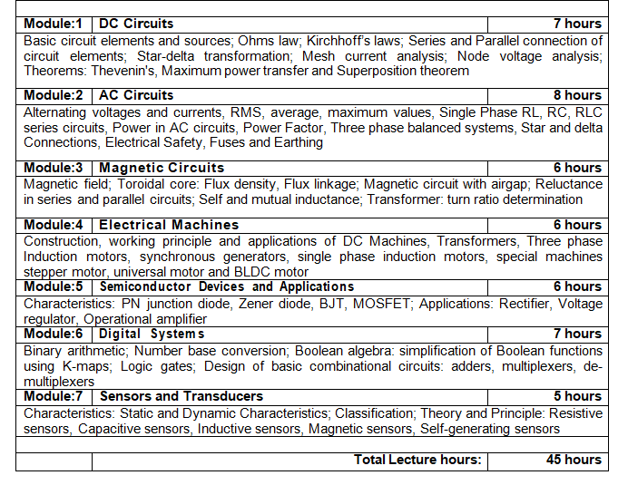
BASIC ELECTRICAL AND ELECTRONICS ENGINEERING (BEEE102L)

Slide 3
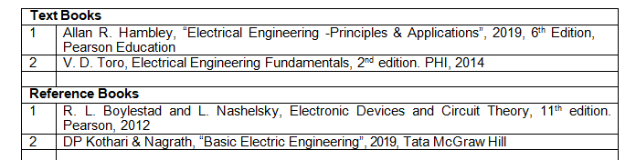
BASIC ELECTRICAL AND ELECTRONICS ENGINEERING (BEEE102L)
LIST OF BOOKS

Slide 4
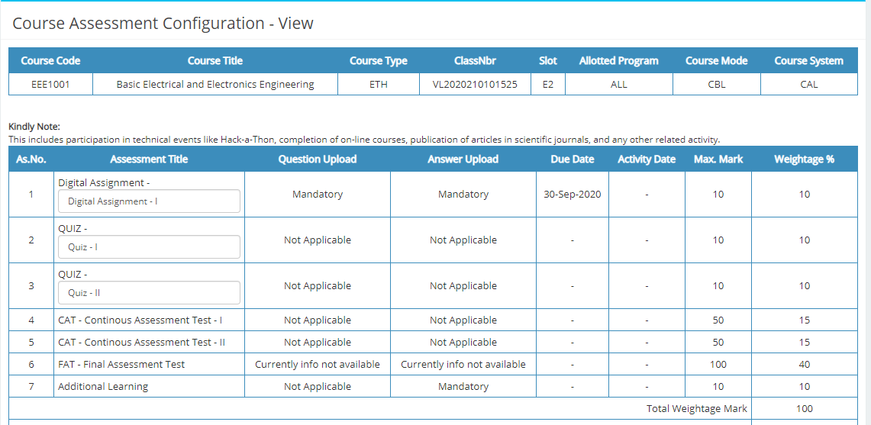
BASIC ELECTRICAL AND ELECTRONICS ENGINEERING LAB (BEEE102L THEORY)
ASSESMENT METHOD

Slide 5
BASIC ELECTRICAL AND ELECTRONICS ENGINEERING (BEEE102L THEORY)
Due dates for lab and theory assessments are fixed and no relaxation will be given for late submission.
CAT 1 and CAT 2 will be conducted OFFLNE. (dates will be mentioned in due course).
Quiz will be conducted either in online mode using teams quiz/ or moodle or schoology (date and mode will be informed before hand).

